Slide 1
Introduction to Data Science and Programming
Regression for prediction
James Larner

Slide 2
What will we do today?
• What is Linear Regression?
• How to build a data model and displaying the data model on a graph
• Understanding the results
• Multiple Regression

Slide 3
What is Linear Regression?
Linear regression is a basic and commonly used type of predictive analysis. The overall idea of regression is to examine two things: (1) does a set of predictor variables do a good job in predicting an outcome (dependent) variable? (2) Which variables in particular are significant predictors of the outcome variable, and in what way do they–indicated by the magnitude and sign of the beta estimates–impact the outcome variable? These regression estimates are used to explain the relationship between one dependent variable and one or more independent variables. The simplest form of the regression equation with one dependent and one independent variable is defined by the formula y = c + b*x, where y = estimated dependent variable score, c = constant, b = regression coefficient, and x = score on the independent variable.
What is Linear Regression? - Statistics Solutions

Slide 4
Exercise
Consider a scenario where we would want to predict something based on data we already hold. For example someone’s weight based on their height.
Write down the data we would use and what it is we would like to predict based on that.

Slide 5
Linear Regression
Take the following example:
https://www.kaggle.com/datasets/karthickveerakumar/salary-data-simple-linear-regression

Slide 6
How to build a data model and displaying the data model on a graph
%matplotlib inline
import numpy as np
import matplotlib.pyplot as plt
x=(1.1,1.3,1.5,2,2.2,2.9,3,3.2,3.2,3.7,3.9,4,4,4.1,4.5,4.9,5.1,5.3,5.9,6,6.8,7.1,7.9,8.2,8.7,9,9.5,9.6,10.3,10.5)
y=(39343,46205,37731,43525,39891,56642,60150,54445,64445,57189,63218,55794,56957,57081,61111,67938,66029,83088,81363,93940,91738,98273,101302,113812,109431,105582,116969,112635,122391,121872)
plt.scatter(x,y)
plt.show

Slide 7
Adding a regression line
The next step is to analyse the data and fit a linear regression model to the data. This is done using the polyfit() function. We also use poly1d() to create the function we will use to display the data points :
#Add a linear regression line
z = np.polyfit(x,y,1)
p = np.poly1d(z)
#Plot a green line
plt.plot(x,p(x),'-g')

Slide 8
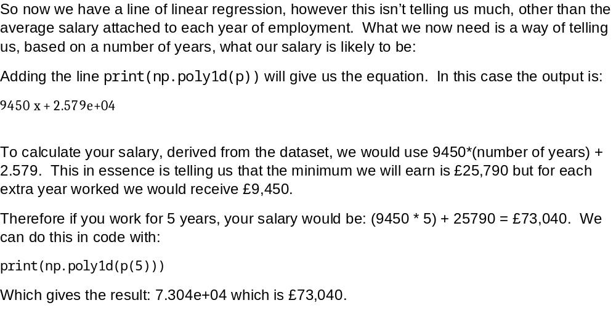
Getting a formula we can use

Slide 9
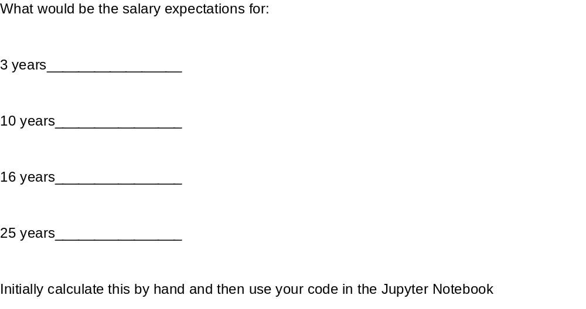
Exercise

Slide 10
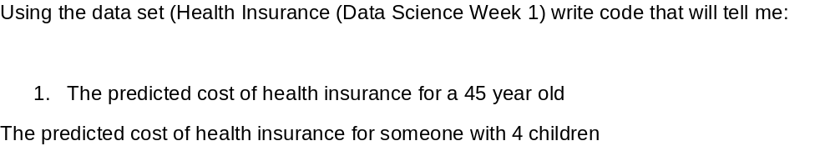
Exercise

Slide 11
Multiple Regression
Multiple regression is like linear regression, but with more than one independent value, meaning that we try to predict a value based on two or more variables.
Take a look at the data set below, it contains some information about cars.

Slide 12
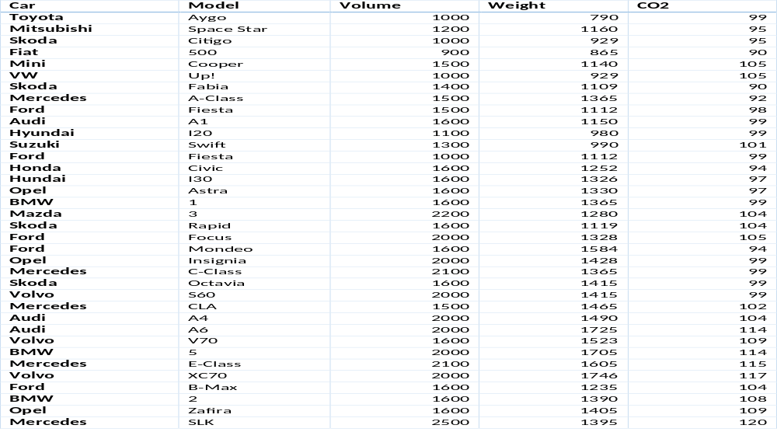
Multiple Regression

Slide 13
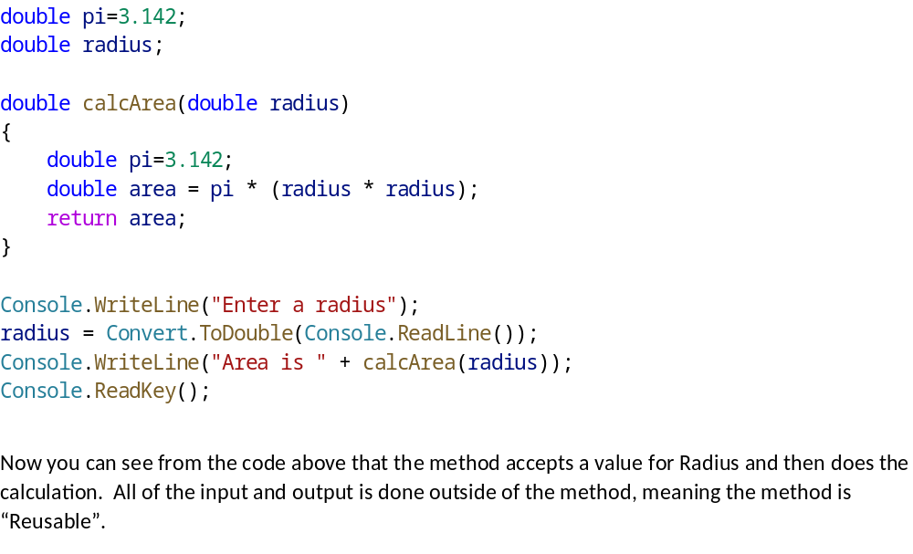
Methods that accept arguments

Slide 14
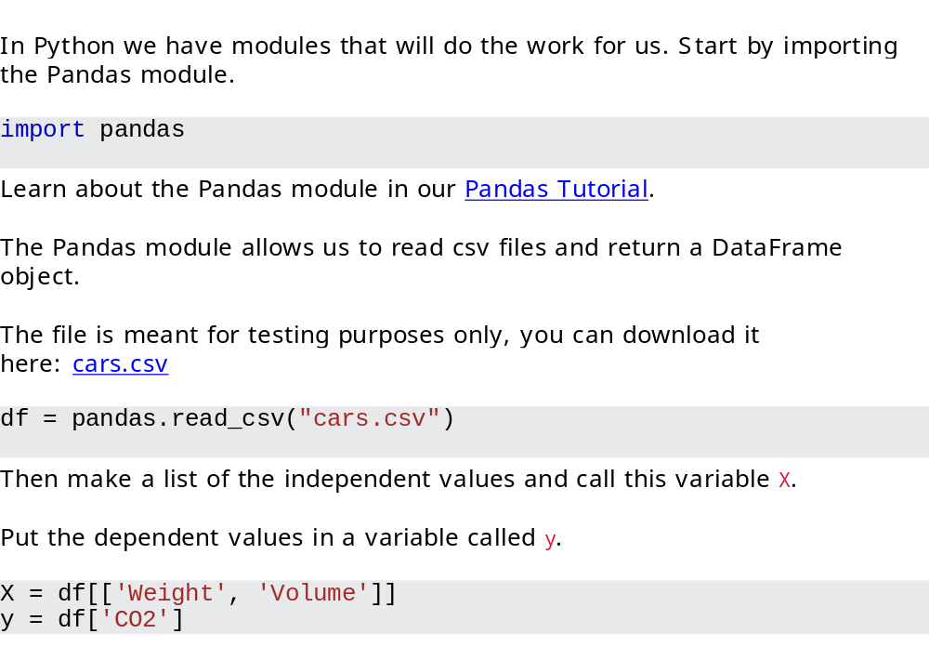
Coding Multiple Regression

Slide 15
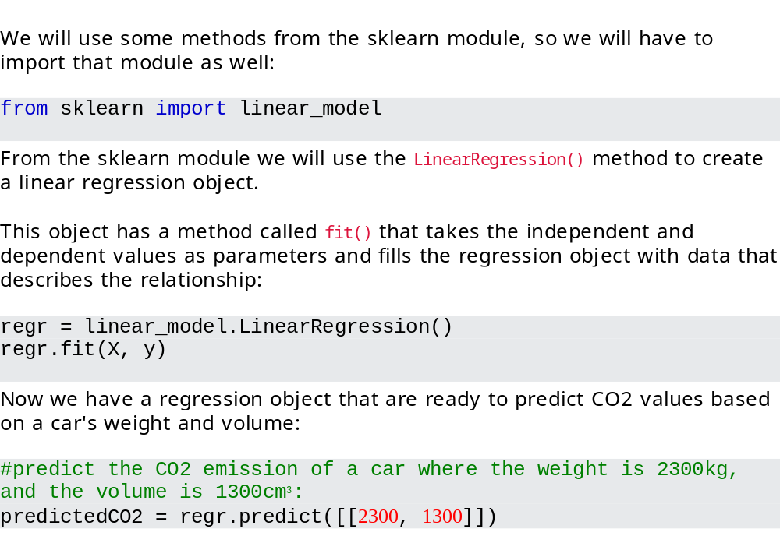
Coding Multiple Regression

Slide 16
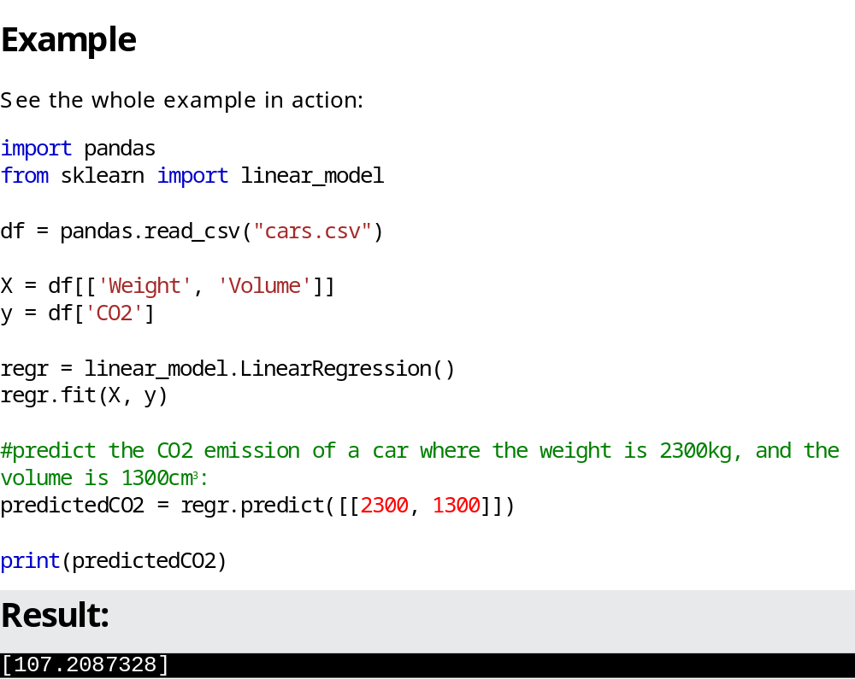
All code

Slide 17
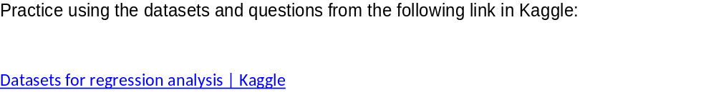
Exercise

